Slide 1
Workday
Performance Management
Goal & Development Item User Guide

Slide 2
Employee Adds Goal

Slide 3
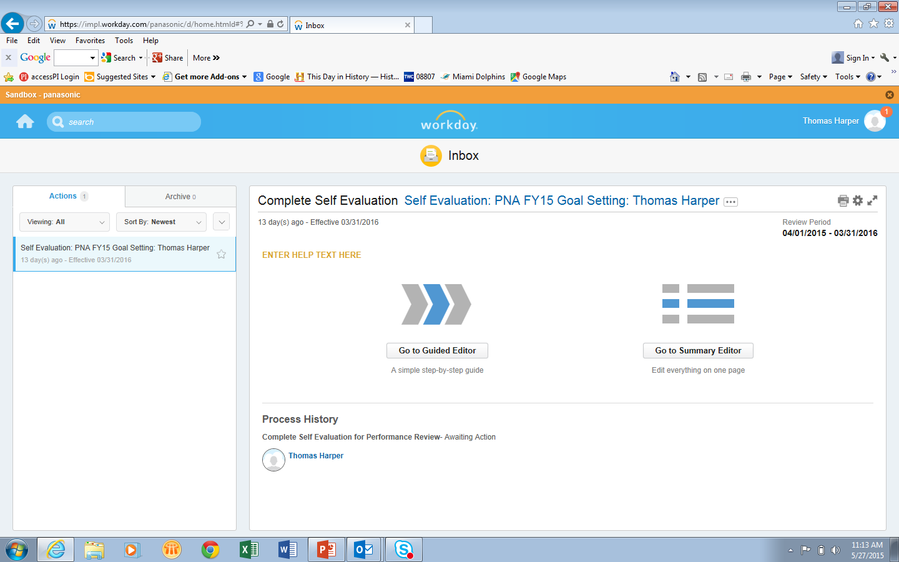
1
Click here to go to Inbox and add Goals
2
Click here to step through
Goals and Development Items
3
Click here to see Goals and Development Items

Slide 4
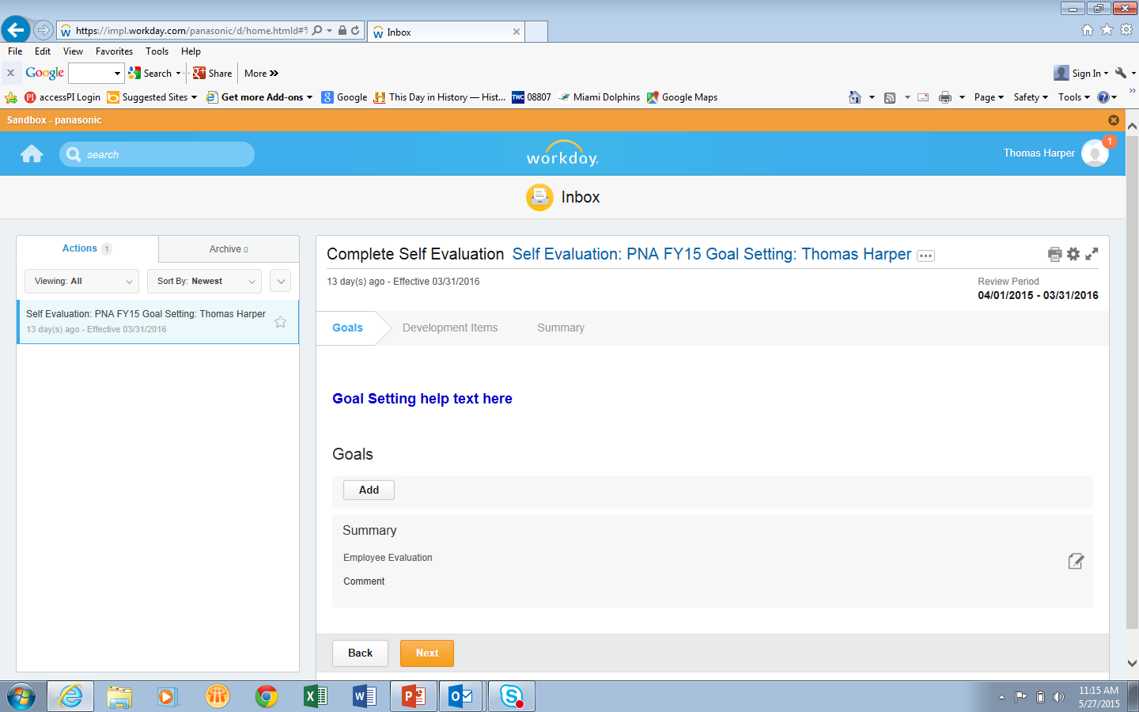
4
Click Add

Slide 5
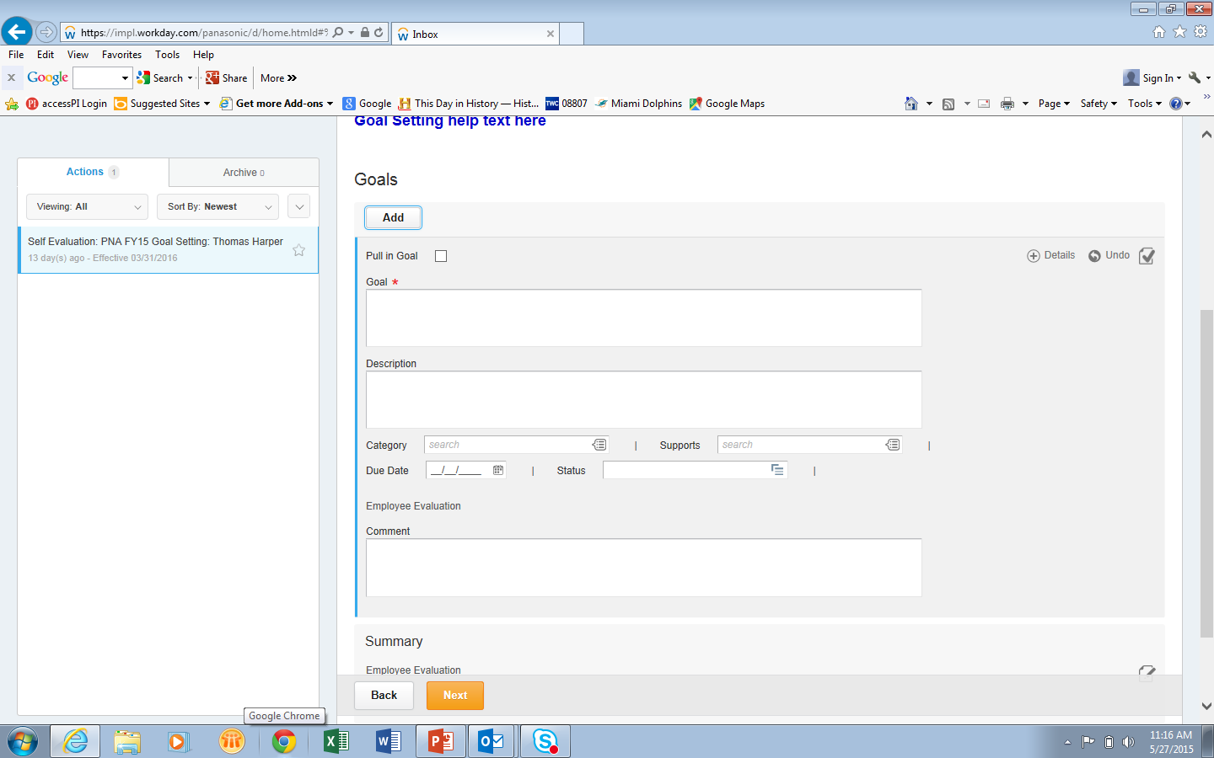
5
Enter Goal Name
6
Supports is not being used by PNA
Enter Goal Details
7
Enter Due Date

Slide 6
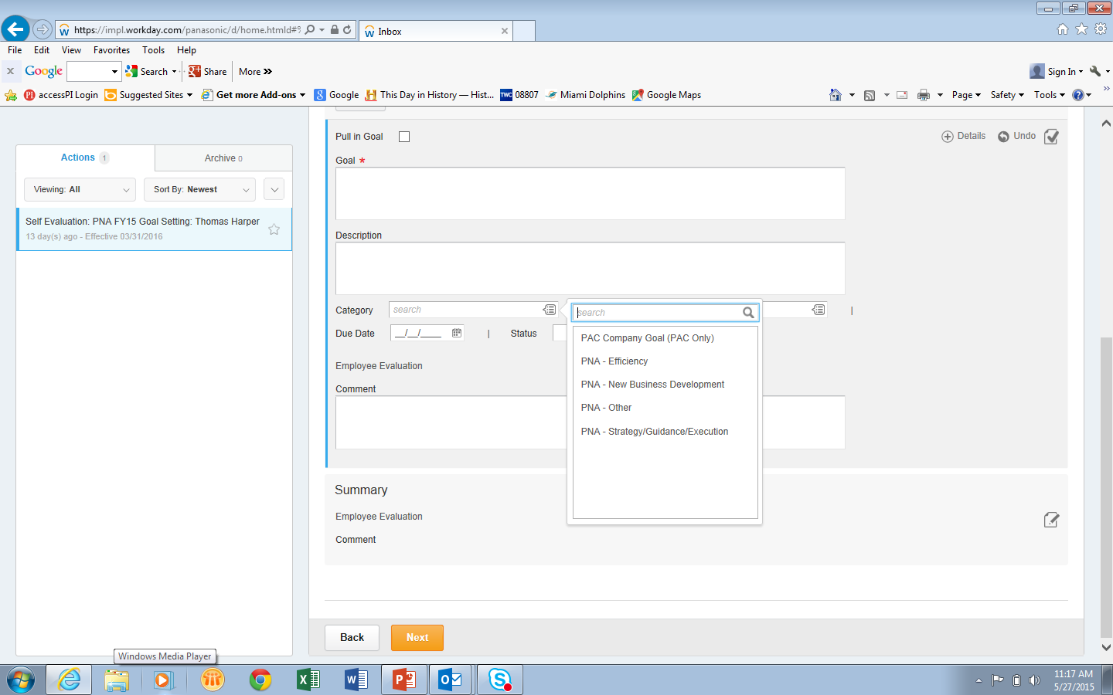
8
Click on Category Pull Down Menu
9
Select appropriate PNA Category

Slide 7
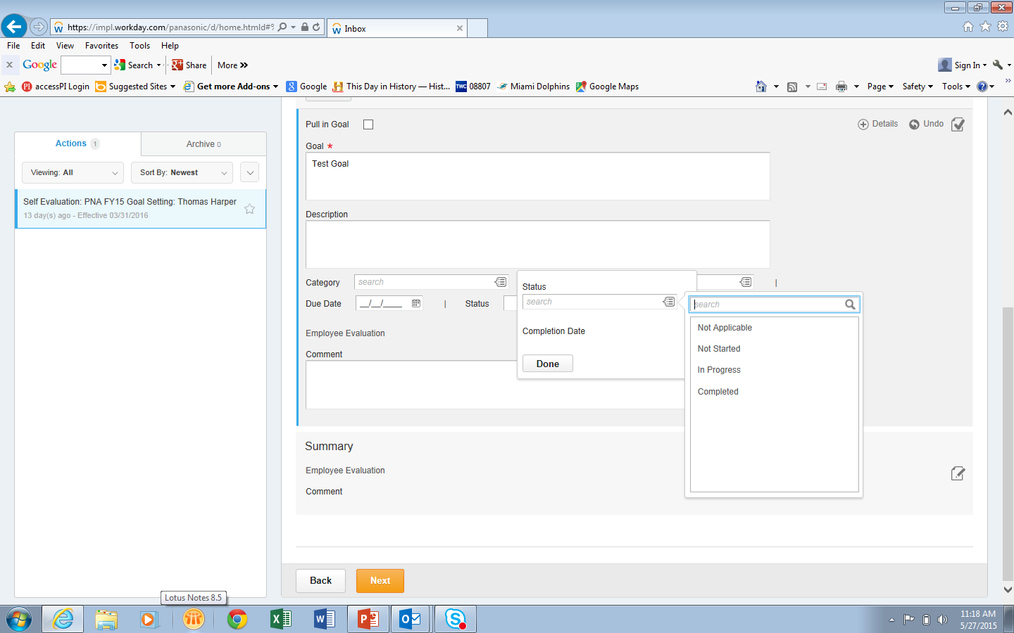
10
Click on Category Pull Down Menu
11
Click on Pull Down Menu
12
Select appropriate Status Category

Slide 8
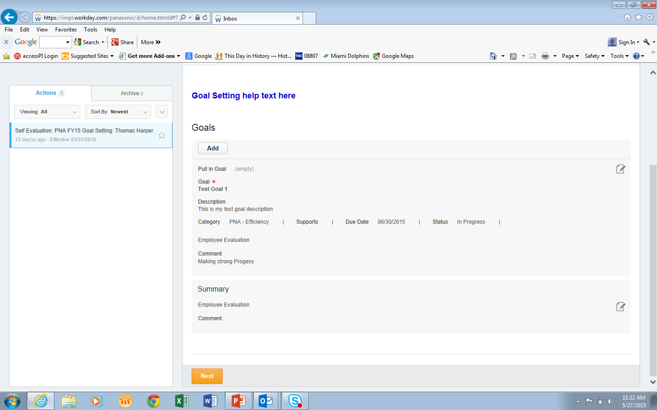
Completed Goal
13
14
Comments are Optional
15
Click Next

Slide 9
Employee Adds Development Item

Slide 10
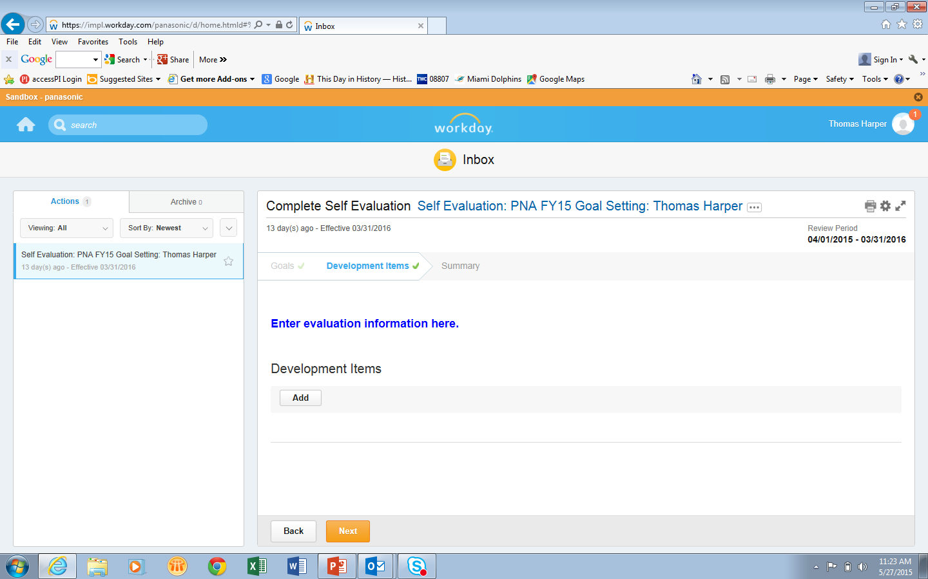
16
Click Add

Slide 11
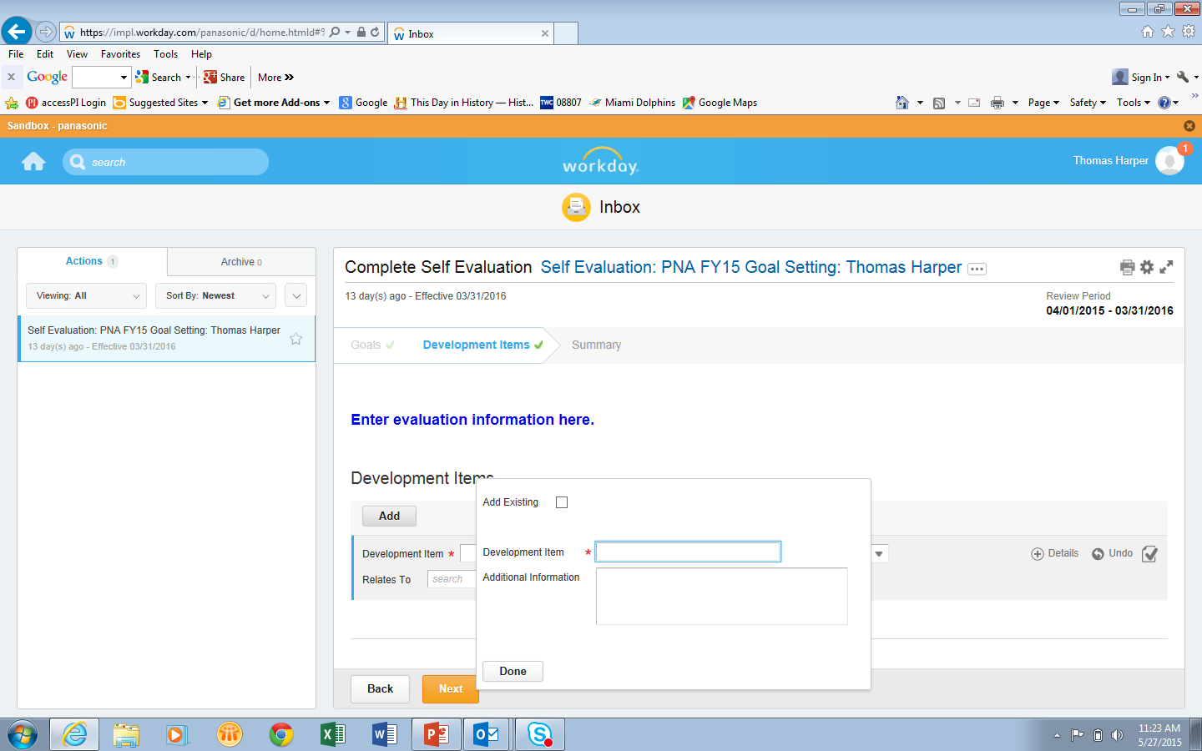
17
Click Development Item
18
Add Development Item
20
Click Done
19
Add Additional Information

Slide 12
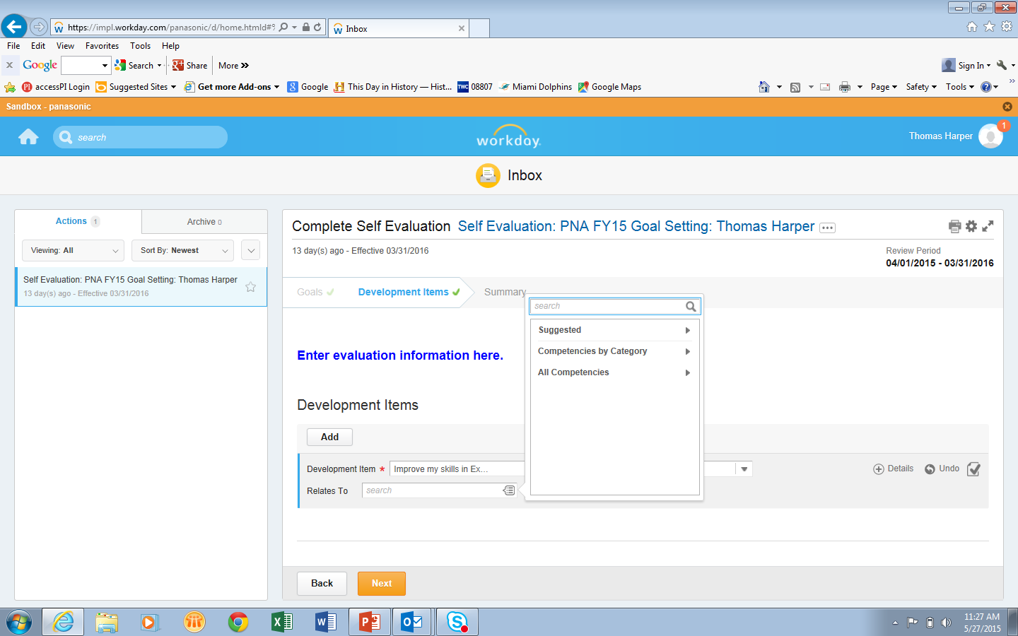
22
Click Competencies by Category
21
Click Relates To

Slide 13
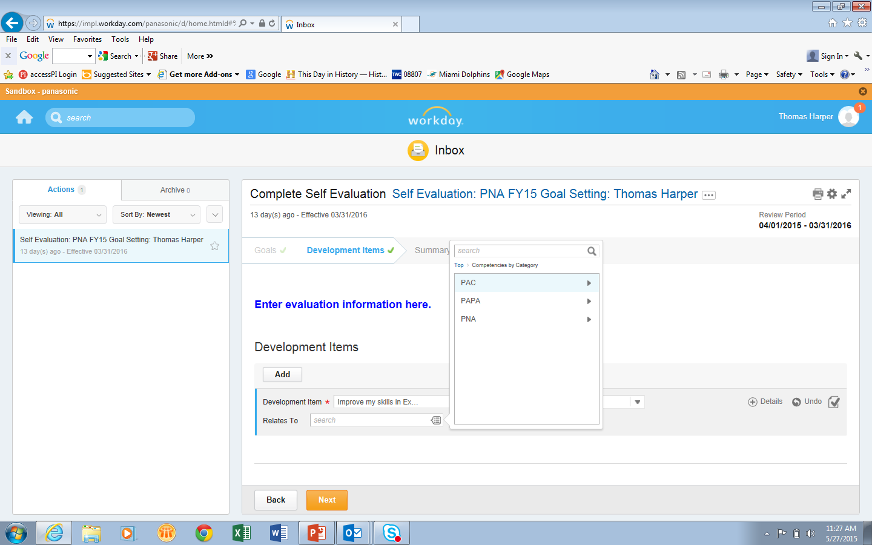
23
PNA

Slide 14
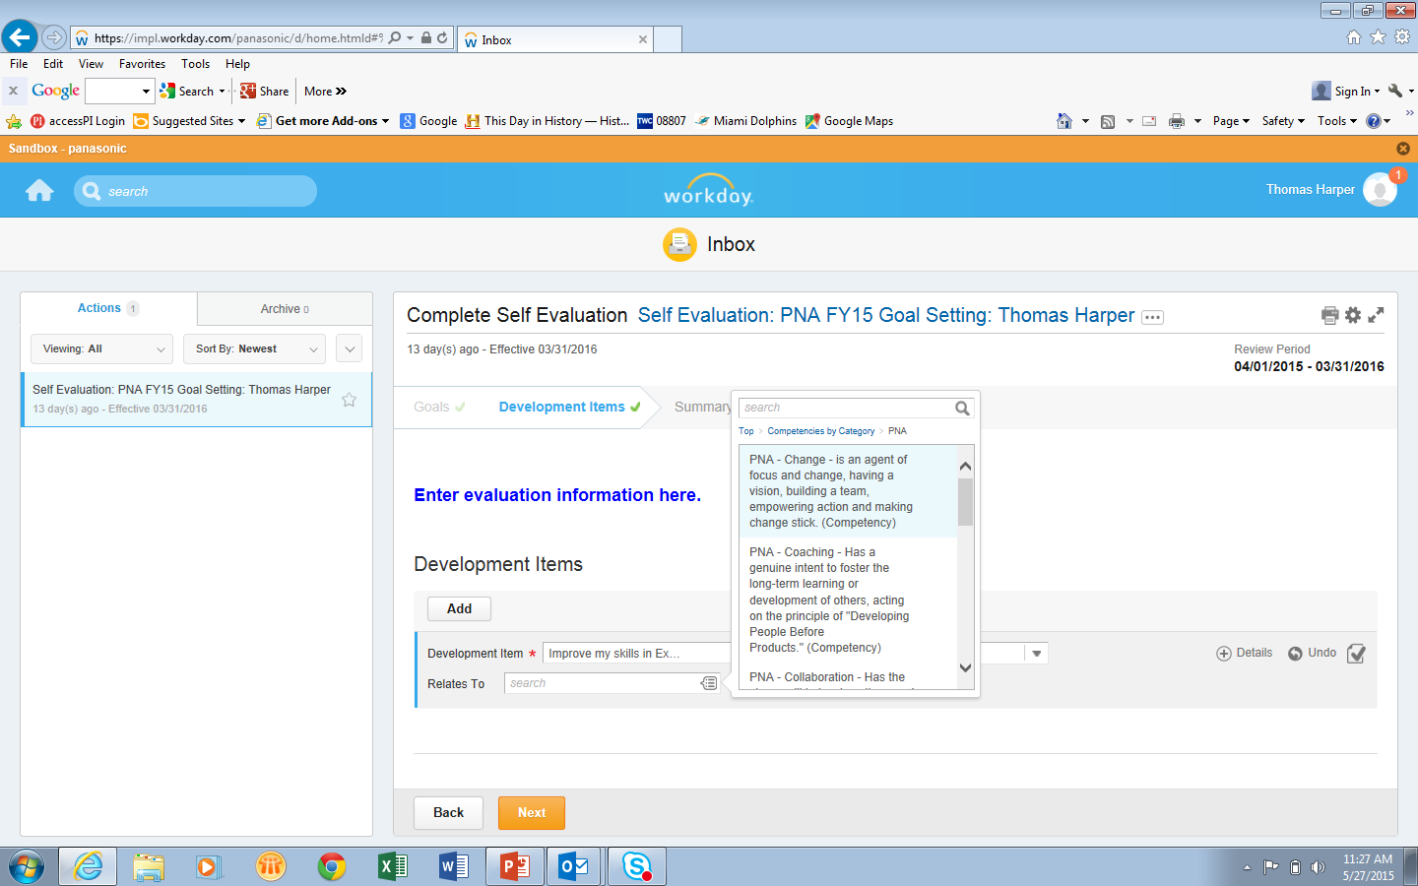
24
Select the Competency

Slide 15
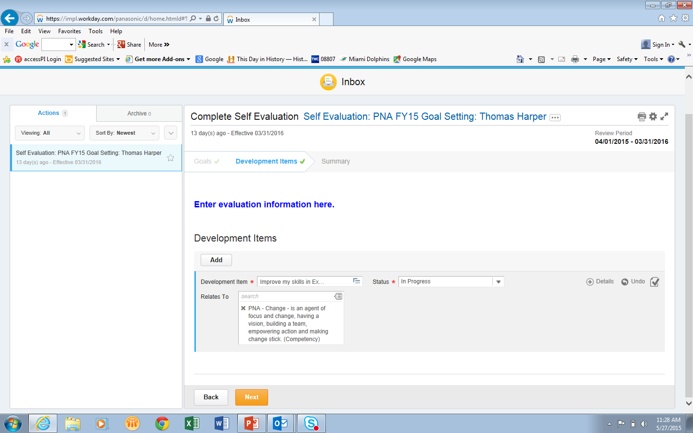
25
Completed Development Item

Slide 16
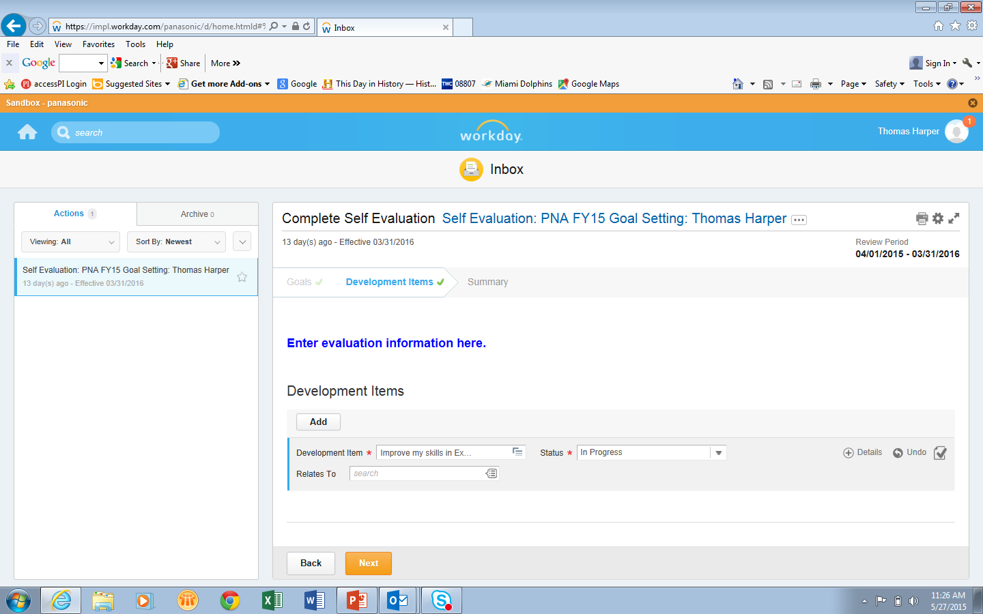
26
Click Next

Slide 17
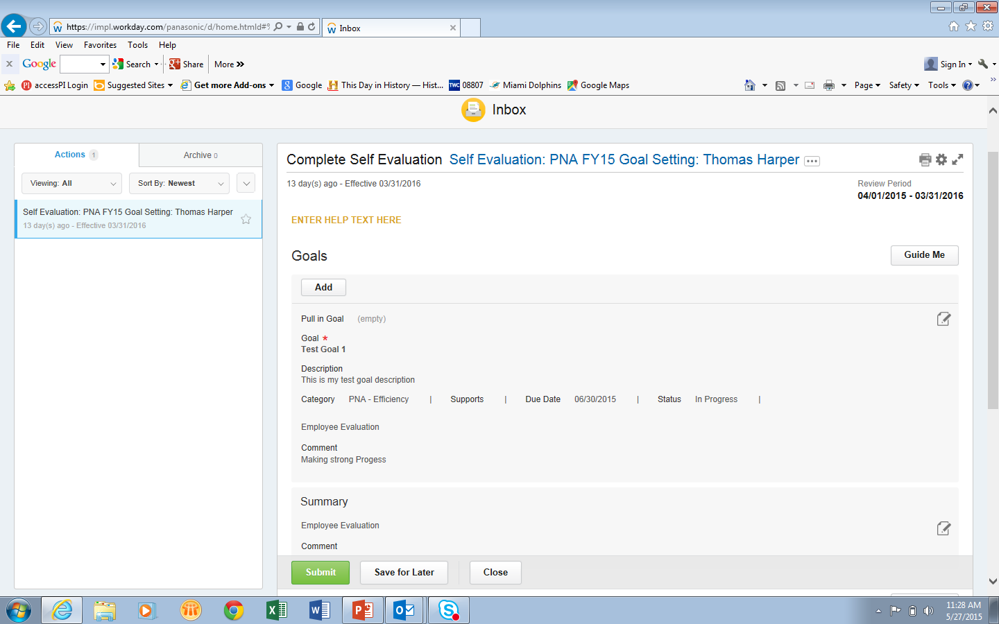
27
Click Submit to send to Manager for Review/Approval

Slide 18
To Edit/Revise Goals

Slide 19
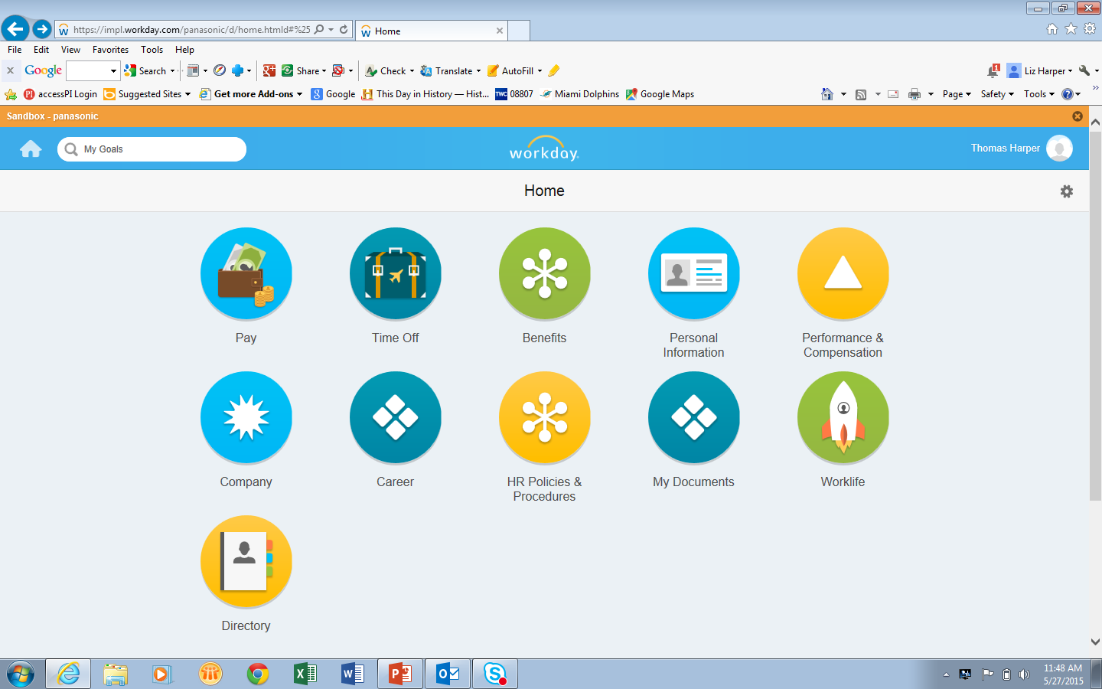
Type My Goals
27

Slide 20
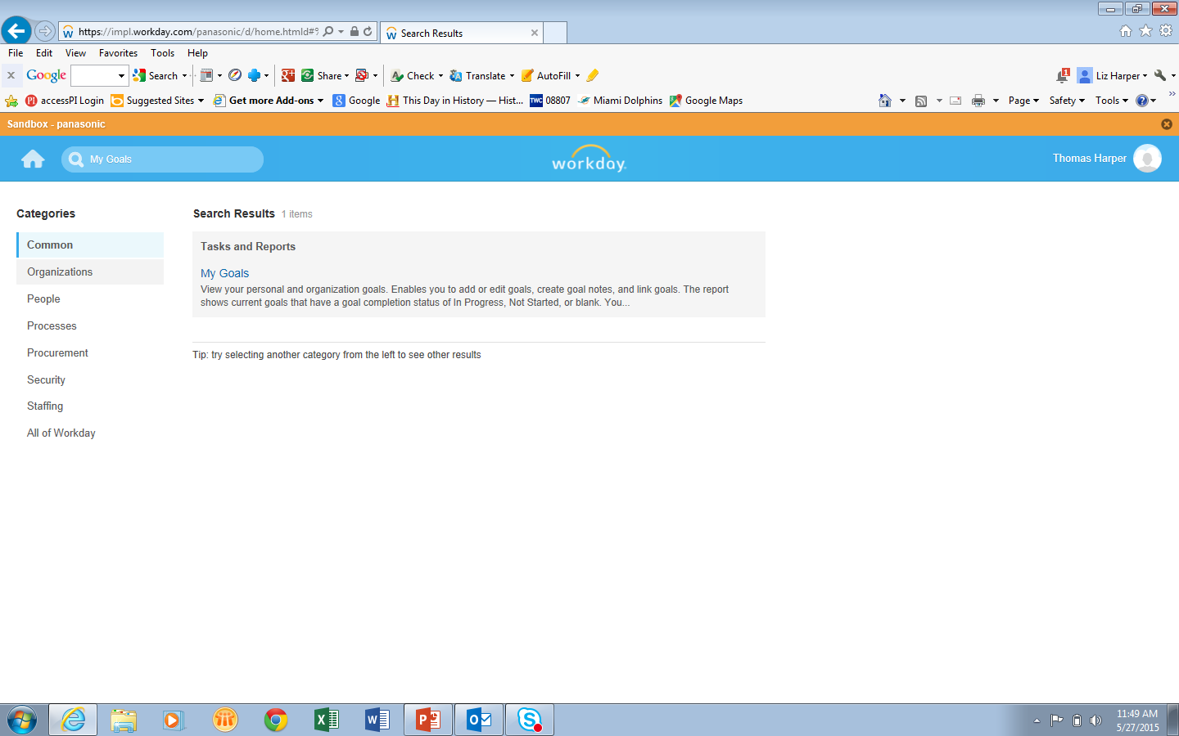
28
Click here

Slide 21
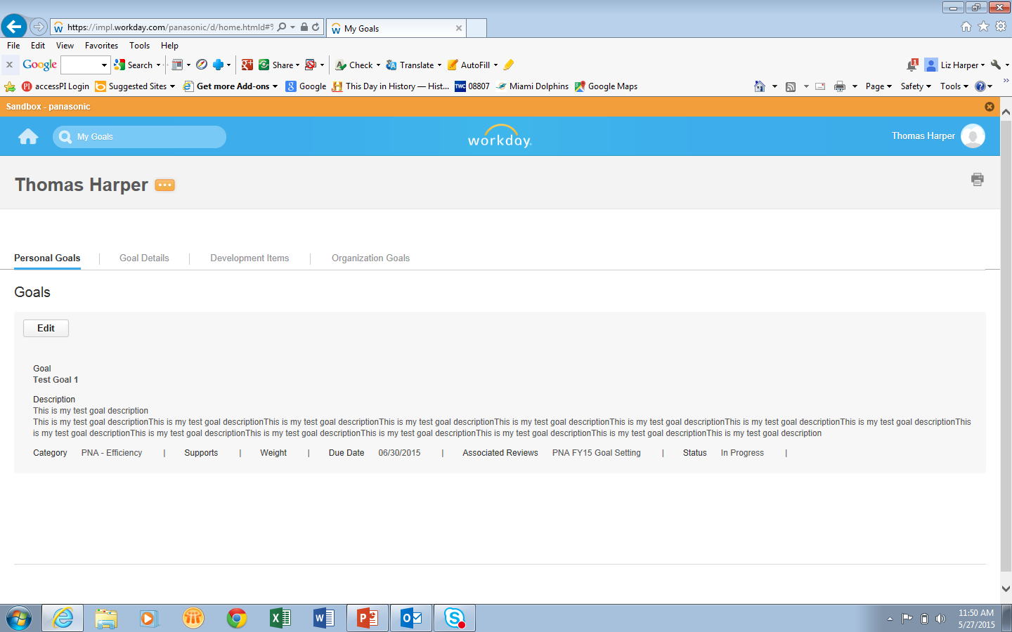
29
Edit Goals

Slide 22
To Copy and Paste Goals

Slide 23
30
Copy and Paste Goals
Copy from Word document
Paste into Goal section

Slide 24
Employee View Add Goal

Slide 25
1
2
6
3
4
5
7

Slide 26
Employee View
Add Development Item

Slide 27
17
Click Development Item
18
Add Development Item
20
Click Done
19
Add Additional Information

